Slide 1
BCSE202L & BCS202P- Data Structures and Algorithms
Dr. Priyanka N
Assistant Professor Senior Grade 1
School of Computer Science & Engineering
VIT, Vellore.

Slide 3
BCS202L- Data Structures and Algorithms
Text Books:
Mark A. Weiss, Data Structures & Algorithm Analysis in C++, 4 th Edition, 2013,Pearson Education.
Reference Books:
Alfred V. Aho, Jeffrey D. Ullman and John E. Hopcroft, Data Structures and Algorithms,1983, Pearson Education.
Horowitz, Sahni and S. Anderson-Freed, Fundamentals of Data Structures in C, 2008, 2nd Edition, Universities Press.
Thomas H. Cormen, C.E. Leiserson, R L. Rivest and C. Stein, Introduction to Algorithms, 2009, 3rd Edition, MIT Press.

Slide 4
Tower of Hanoi
The tower of Hanoi is one of the main applications of recursion
It says, ‘if you can solve n–1 cases, then you can easily solve the nth case’

Slide 5
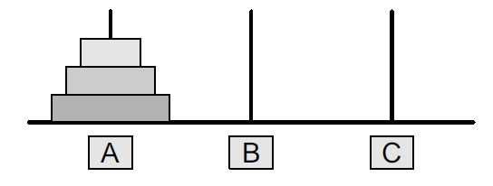
Tower of Hanoi
Three rings mounted on pole A
The problem is to move all these rings from pole A to pole C while maintaining the same order
The main issue is that the smaller disk must always come above the larger disk

Slide 6
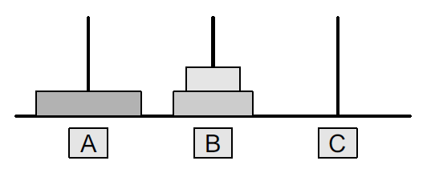
Tower of Hanoi
We will be doing this using a spare pole
In this case, A is the source pole, C is the destination pole, and B is the spare pole
To transfer all three rings from A to C, we will first shift the upper two rings (n–1 rings) from the source pole to the spare pole
We move the first two rings from pole A to B

Slide 7
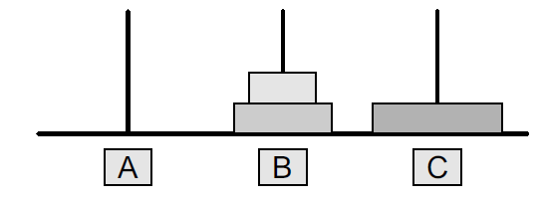
Tower of Hanoi
Now that n–1 rings have been removed from pole A, the nth ring can be easily moved from the source pole (A) to the destination pole (C)

Slide 8
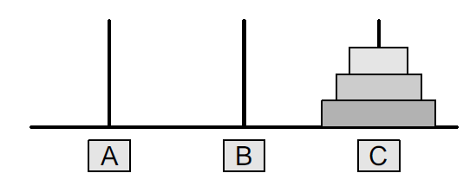
Tower of Hanoi
The final step is to move the n–1 rings from the spare pole (B) to the destination pole (C)

Slide 9
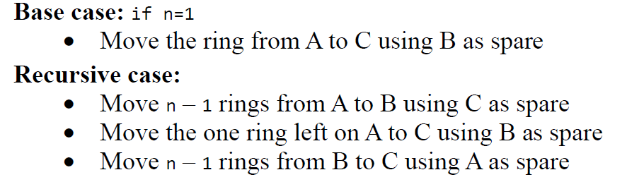
Tower of Hanoi
To summarize, the solution to our problem of moving n rings from A to C using B as spare can be given as:

Slide 10
Program code
#include <stdio.h>
void towers(int, char, char, char);
int main()
{
int num;
printf("Enter the number of disks : ");
scanf("%d", &num);
printf("The sequence of moves involved in the Tower of Hanoi are :\n");
towers(num, 'A', 'C', 'B');
return 0;
}
void towers(int num, char source, char destination, char spare)
{
if (num == 1)
{
printf("\nMove disk 1 from pole %c to pole %c", source, destination);
return;
}
// Recursively calling function twice
towers(num - 1, source, spare, destination);
printf("\nMove disk %d from pole %c to pole %c", num, source, destination);
towers(num - 1, spare, destination, source);
}

Slide 11
